Slide 1

Data Preparation/Exploration
Week 2
Semester 1, 2025
Dr. Farshid Keivanian

Slide 2
Unit Learning Outcomes
LO3 Apply data mining tools and techniques to generate human- interpretable patterns that describe the data (GA5, GA10)

Slide 3

What are we doing this week?
Data exploration
Data scrubbing
Solutions for handling missing and inconsistent data
Data and attribute reduction
Getting started with RapidMiner

Slide 4
Understanding Data Scrubbing: Fixing Errors in Data
Even when we try our best to collect data accurately, mistakes and errors can still happen. These mistakes can affect the quality of our analysis, so we need to clean the data before using it. This process is called data scrubbing, and it helps us handle different types of data issues, such as:
Missing data (blank or unknown values)
Inconsistent data (values that don’t make sense)
Reducing unnecessary data (removing extra records)
Removing unnecessary attributes (removing columns that are not useful)

Slide 5
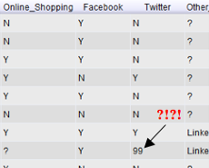
Understanding Data Scrubbing: Fixing Errors in Data
What is Inconsistent Data?
Inconsistent data means a value exists, but it is not correct or meaningful. It is different from missing data.
For example, in the image below, the Twitter column should only contain "Y" (Yes) or "N" (No). However, there is a "99", which does not make sense. This is an example of inconsistent data.
(Refer to the attached image)

Slide 6
Understanding Data Scrubbing: Fixing Errors in Data
How to Handle Missing Data?
Sometimes, we can replace missing values using Measures of Central Tendency, which help find typical values in the data:
Mean – The average of all values
Median – The middle value in a sorted list
Mode – The most common value
When replacing missing or inconsistent data, we should always use logic, common sense, and transparency to avoid introducing errors.

Slide 7
Understanding Data Scrubbing: Fixing Errors in Data
Preparing Data for Analysis
Before using data in a data science algorithm, we need to check for:
Outliers (values that are too high or too low)
Missing values (empty spaces in the dataset)
Highly correlated attributes (columns that are too similar)
Some machine learning algorithms do not work well when attributes are too similar, so we might need to remove them.

Slide 8
Understanding Data Scrubbing: Fixing Errors in Data
Key Takeaway
Cleaning and preparing data is an important step before any analysis. Whether we remove, replace, or modify data, we must always make sure the changes make sense for our project.

Slide 9
Understanding Data Scrubbing: Fixing Errors in Data
Problem-Solving Question:
Mean, Median, Mode Calculation
Problem: Given the numbers: 12, 15, 18, 21, 15, 16, 15, 17, × compute:
Mean
Median
Mode Which measure is the best choice for replacing a missing value in this dataset?

Slide 10
Understanding Data Scrubbing: Fixing Errors in Data
Solution:
Mean = (12 + 15 + 18 + 21 + 15 + 16 + 15 + 17) / 8 = 16.125
Median = Middle value in sorted data (15, 15, 15, 16, 17, 18, 21) → 15.5
Mode = Most frequent value → 15
What is the Best Choice?

Slide 11
Understanding Data Scrubbing: Fixing Errors in Data
The mode (15) appears most frequently in the dataset, making it a natural choice for replacing missing values.
The mean (16.125) could also work, but it might introduce a decimal value in a dataset where all values are whole numbers.
The median (15.5) is another reasonable option, but mode is typically preferred for missing value replacement when dealing with categorical or frequently occurring values.
Best Choice: Mode (15) because it represents the most common value in the dataset.

Slide 12
Understanding Data Scrubbing: Fixing Errors in Data
When Do We Choose Mean?
The mean is typically chosen when:
The data is symmetrically distributed without extreme values (outliers).
We want to represent the overall balance of the dataset.
The dataset contains continuous numerical data rather than categorical data.
However, if there are outliers (e.g., a very high or low number compared to the rest), the mean might not be the best choice, and the median could be more reliable.

Slide 13
Introduction to Inferential Statistics in Data Science and Software Engineering
Inferential statistics is an important part of data science. It helps us make predictions and decisions based on small samples of data instead of analyzing the whole population. Imagine you want to know the average height of students in a university. Measuring every student is unrealistic, so instead, you take a sample and use inferential statistics to estimate the height of all students.

Slide 14
Introduction to Inferential Statistics in Data Science and Software Engineering
Unlike descriptive statistics, which just summarizes data (like averages and percentages), inferential statistics allows us to predict and test ideas about a bigger group. This is especially useful in software engineering, where decisions need to be made based on limited data, such as user testing results or system performance analysis.

Slide 15
Introduction to Inferential Statistics in Data Science and Software Engineering
Inferential statistics helps us draw conclusions about a population using a sample. Since collecting data from everyone is usually impossible or impractical, we use methods like:
Hypothesis Testing – Checking if a claim about data is true or not. (Example: Does a new app update improve user engagement?)
Confidence Intervals – Estimating a range where a value (like average income) is likely to fall.
Regression Analysis – Understanding relationships between variables. (Example: Does advertising spending affect sales?)
These techniques help data scientists and software engineers make informed decisions, predict trends, and improve systems based on limited but meaningful data.

Slide 16
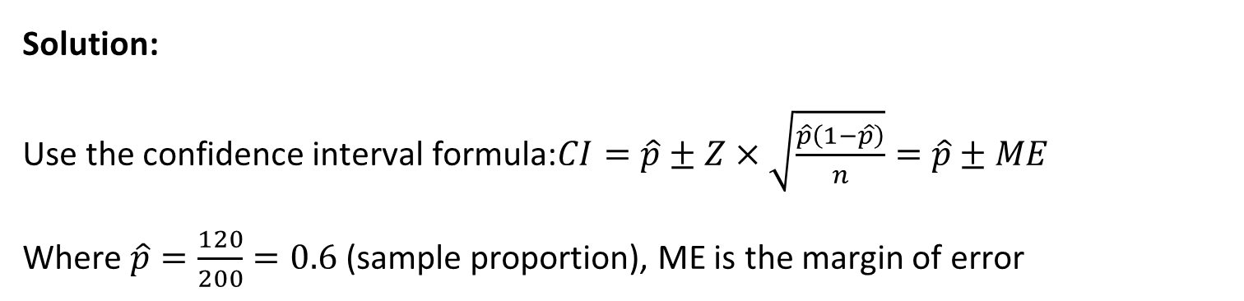
Estimating Population Proportion Using Confidence Intervals
Math Problem-Solving Question
Question: A survey is conducted on a sample of 200 university students, and 120 say they prefer online learning. Estimate the proportion of all university students who prefer online learning with a 95% confidence interval.
Solution: Use the confidence interval formula:$CI=\hat{p}±Z×\sqrt{\frac{\hat{p}\left(1−\hat{p}\right)}{n}}=$ $\hat{p}±ME$
Where $\hat{p}=\frac{120}{200}=0.6$ (sample proportion), ME is the margin of error

Slide 17
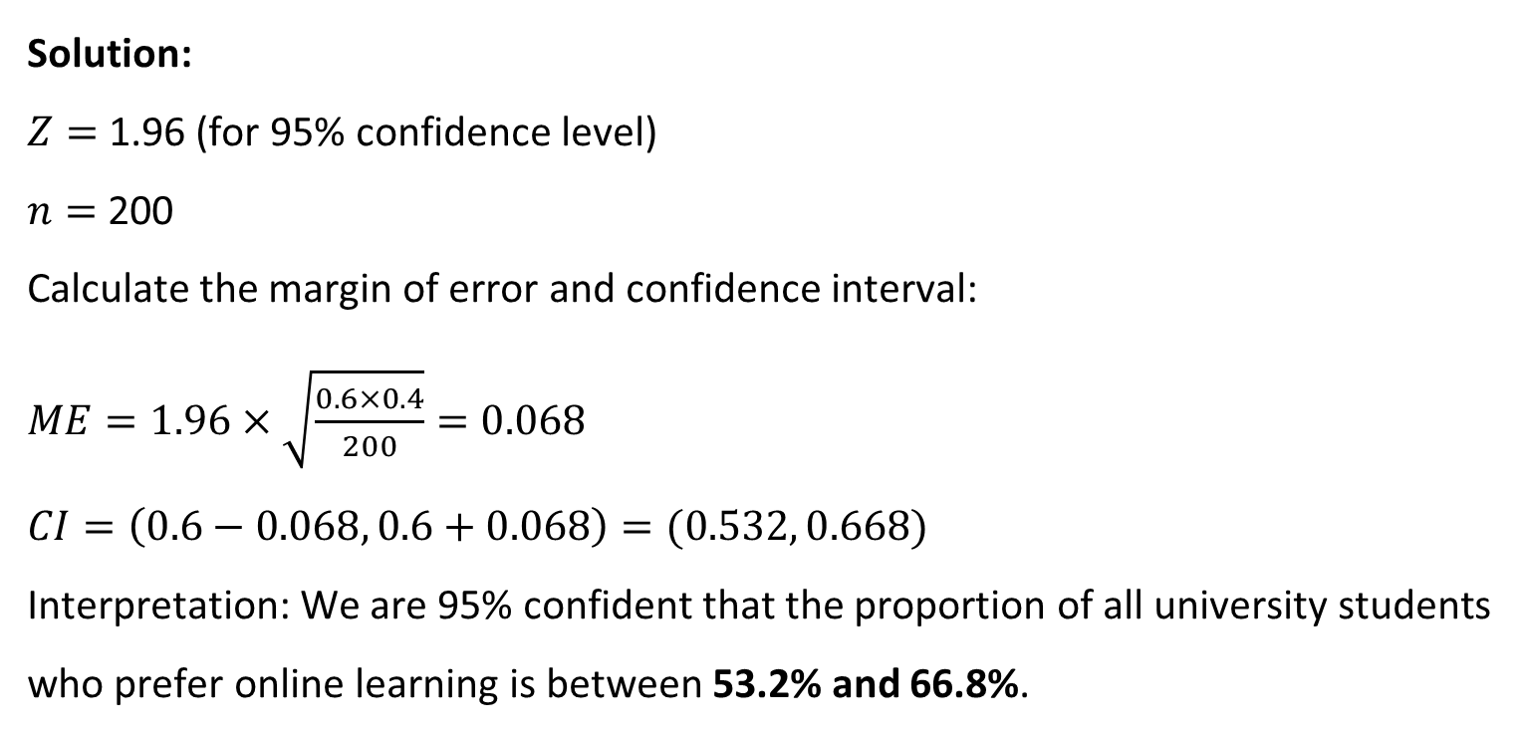
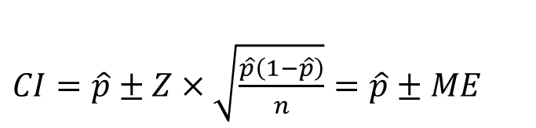
Estimating Population Proportion Using Confidence Intervals
Solution: $Z=$ 1.96 (for 95% confidence level)
$n=$ 200
Calculate the margin of error and confidence interval:
$ME=1.96×\sqrt{\frac{0.6×0.4}{200}}=0.068$
$CI=\left(0.6−0.068, 0.6+0.068\right)=(0.532, 0.668)$
Interpretation: We are 95% confident that the proportion of all university students who prefer online learning is between 53.2% and 66.8%.
$CI=\hat{p}±Z×\sqrt{\frac{\hat{p}\left(1−\hat{p}\right)}{n}}=$ $\hat{p}±ME$

Slide 18
Estimating Population Proportion Using Confidence Intervals
Role-Playing Debate Questions
Should businesses rely on statistical sampling, or should they try to collect data from every customer? One team supports sampling, the other group argue that data must be collected from every customer
One team supports sampling (cost-effective, fast, reliable).
The other argues that complete data collection prevents bias and ensures accuracy.

Slide 19
Estimating Population Proportion Using Confidence Intervals
Role-Playing Debate Questions
Are machine learning models just advanced inferential statistics, or do they go beyond it?
One team argues that machine learning is just a form of statistical inference.
The other claims ML brings more than just statistical predictions.

Slide 20
Understanding P-Values and Significance Levels: A Simple Guide to Hypothesis Testing
When we do research or analyze data, we often ask: "Is this result just random, or is there really something going on?" That's where p-values and significance levels come in!
Think of a p-value as a "surprise score"—it tells us how surprising our results are if the null hypothesis (H₀) were true. A smaller p-value means our results are less likely due to pure chance.
The significance level (α) is the cutoff we set before testing. Usually, we use 0.05 (or 5%), meaning we are okay with a 5% chance of making a wrong conclusion (Type I error).

Slide 21
Understanding P-Values and Significance Levels: A Simple Guide to Hypothesis Testing
How to Interpret P-Values?
If p-value < α (e.g., 0.05): → We reject the null hypothesis → The result is statistically significant
If p-value > α (e.g., 0.05): → We fail to reject the null hypothesis → The result is not significant

Slide 22
Understanding P-Values and Significance Levels: A Simple Guide to Hypothesis Testing
Problem
A company claims that their new training program improves employee productivity. A researcher collects data and runs a hypothesis test, getting a p-value of 0.03. They set their significance level (α) at 0.05.
Question: Should the researcher reject the null hypothesis?

Slide 23
Understanding P-Values and Significance Levels: A Simple Guide to Hypothesis Testing
The p-value (0.03) is less than the significance level (0.05).
This means the result is statistically significant.
Conclusion: The researcher rejects the null hypothesis and concludes that the training program likely improves productivity!

Slide 24
Understanding P-Values and Significance Levels: A Simple Guide to Hypothesis Testing
Key Takeaways
P-value = surprise score (lower means stronger evidence)
Significance level (α) = the threshold for deciding
If p-value < α, reject H₀; otherwise, do not reject H₀

Slide 25
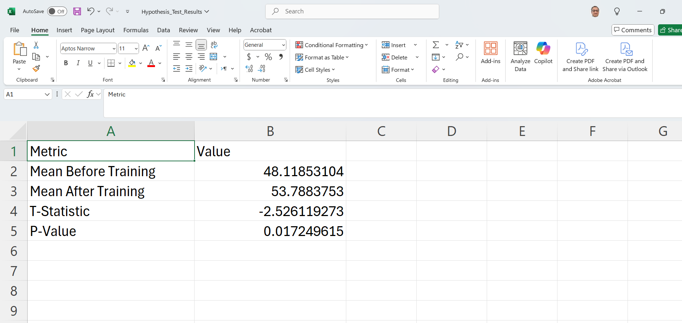
Understanding P-Values and Significance Levels: A Simple Guide to Hypothesis Testing
Sample Hypothesis Test Results:
The hypothesis test results are displayed in the table. Since the p-value is less than 0.05, we reject the null hypothesis. This means the training program likely had a significant impact on employee productivity!

Slide 26
Key Descriptive Statistics: Mean, Median, Mode, Standard Deviation, and Variance
How to calculate mean, median, mode, standard deviation, and variance:
Mean:
The mean is the sum of a collection of numbers divided by the count of numbers in the collection. For example, the mean of the numbers 1, 2, 3 is: (1+2+3)/3 = 2

Slide 27
Key Descriptive Statistics: Mean, Median, Mode, Standard Deviation, and Variance
Median:
The median is the middle number in a sorted list of numbers. If the number of observations is odd, the median is the exact middle number.
For example, for the numbers 1, 2, 3, 4, 5 the median is 3. For the numbers 1, 3, 3, 7, 8, 9 the median is (3+7)/2 = 5.

Slide 28
Key Descriptive Statistics: Mean, Median, Mode, Standard Deviation, and Variance
Mode:
The mode is the number that appears most frequently in a data set. A data set may have more than one mode or no mode at all.
For example, for the numbers 1, 2, 2, 3, 4 the mode is 2.

Slide 29
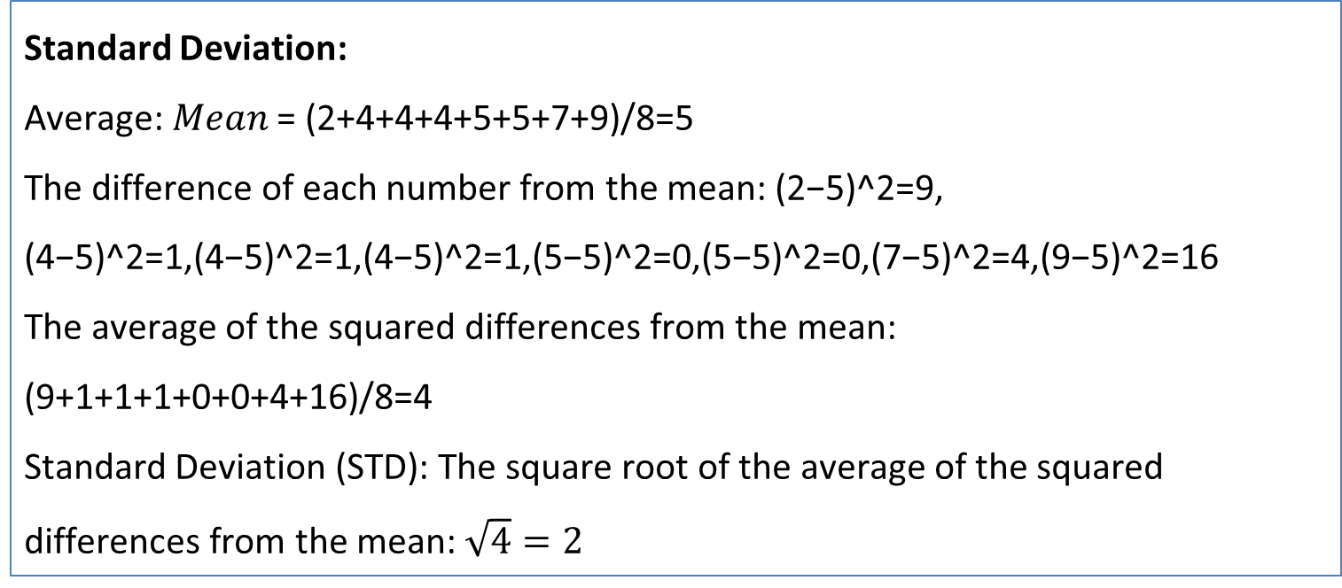
Key Descriptive Statistics: Mean, Median, Mode, Standard Deviation, and Variance
Standard Deviation:
Average: 𝑀𝑒𝑎𝑛 = (2+4+4+4+5+5+7+9)/8=5
The difference of each number from the mean: (2−5)^2=9, (4−5)^2=1,(4−5)^2=1,(4−5)^2=1,(5−5)^2=0,(5−5)^2=0,(7−5)^2=4,(9−5)^2=16
The average of the squared differences from the mean:
(9+1+1+1+0+0+4+16)/8=4
Standard Deviation (STD): The square root of the average of the squared differences from the mean: $\sqrt{4}=2$

Slide 30
Key Descriptive Statistics: Mean, Median, Mode, Standard Deviation, and Variance
Variance:
The average of the squared differences from the mean. This provides a measure of how much each number in the set differs from the mean and from each other. Example: Continuing the example of standard deviation, the variance will be equivalent to the square of the standard deviation, which in this case is approximately equal to 4 (since the standard deviation was 2).

Slide 31
Key Descriptive Statistics: Mean, Median, Mode, Standard Deviation, and Variance
Conclusion:
Inferential statistics offers powerful tools for data analysis, enabling predictions and decisions to be made based on sample data. Through understanding and applying these methods, we can gain valuable insights into data and contribute to effective decision-making processes in software engineering and beyond.

Slide 32
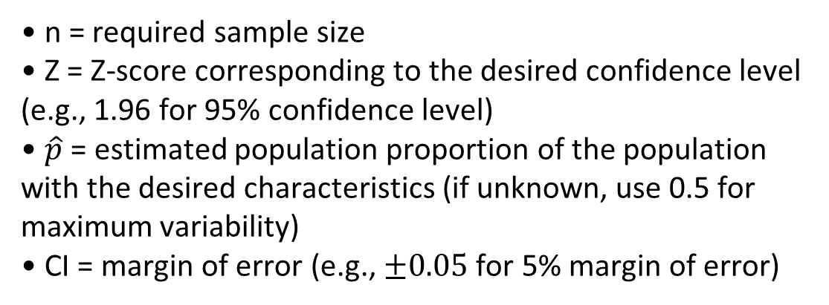
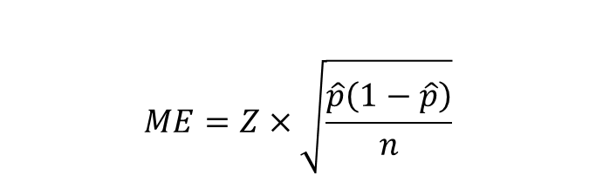
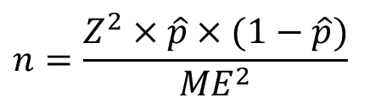
We can extract the following formula for determining the appropriate sample size in studies. The sample size calculation is based on several key factors, including the desired level of confidence (confidence level), the margin of error (also known as precision), the variability in the population (standard deviation or proportion), and the size of the total population being studied.
$$ME=Z×\sqrt{\frac{\hat{p}\left(1−\hat{p}\right)}{n}}$$
$$n=\frac{Z^{2}×\hat{p}×(1−\hat{p})}{{ME}^{2}}$$
n = required sample size
Z = Z-score corresponding to the desired confidence level (e.g., 1.96 for 95% confidence level)
$\hat{p}$ = estimated population proportion of the population with the desired characteristics (if unknown, use 0.5 for maximum variability)
CI = margin of error (e.g., $±0.05$ for 5% margin of error)

Slide 33
SurveySampleSizer: Determining the appropriate sample size to assess public satisfaction with Sydney's new public transportation system
Example Scenario:
You are conducting a study in Sydney, Australia to assess the public satisfaction with a new public transportation system. You want to ensure that your sample size is appropriate to represent the entire population of Sydney, and you aim to achieve a 95% confidence level with a 5% margin of error. Since you are unsure about the population proportion (satisfaction rate), you assume it is 50% for maximum variability.

Slide 34
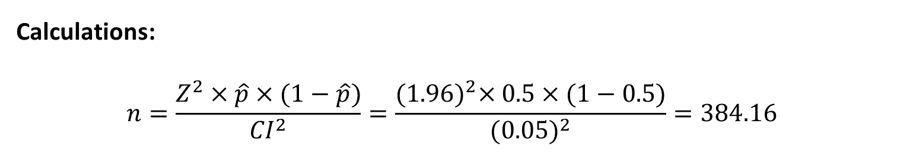
SurveySampleSizer: Determining the appropriate sample size to assess public satisfaction with Sydney's new public transportation system
Calculations:
$$n=\frac{Z^{2}×\hat{p}×(1−\hat{p})}{{CI}^{2}}=\frac{{(1.96)}^{2}×0.5×(1−0.5)}{{(0.05)}^{2}}=384.16$$
Thus, we would need a sample size of approximately 385 respondents to ensure our study results are statistically significant. (not by random)

Slide 35
Interactive Questions
5. Effects of Changing Variables:
Question: What happens to the required sample size if we increase the margin of error to 0.10? Conversely, what happens if we reduce it to 0.02? Why do these changes occur?
Expected Answer: Increasing the margin of error to 0.10 will decrease the required sample size, as we are allowing more variability in our estimate. Reducing the margin of error to 0.02 will increase the sample size, as we are aiming for greater precision in our estimate.

Slide 36
Interactive Questions
6. Real-World Applications:
Question: Suppose you are conducting a survey to estimate customer satisfaction in a large company. Why is it important to calculate the required sample size, and how would you explain the significance of margin of error and confidence level to a non-technical audience?
Expected Answer: Calculating the required sample size is crucial to ensure that the survey results accurately represent the entire customer base. The margin of error indicates the potential difference between the survey results and the true customer satisfaction, while the confidence level reflects how certain we are that the survey results fall within this margin.

Slide 37
Interactive Activity
Activity: Modify the values of p, ME, and Z in the code to see how they affect the required sample size. After making each change, rerun the code and record the results. Try the following:
Change the margin of error (E) to 0.02. What happens to the sample size?
Change the confidence level by using a Z-score of 2.58 (99% confidence). How does this affect the sample size?
Change the estimated proportion (p) to 0.7. What impact does this have on the required sample size?

Slide 38
Interactive Activity
Expected Outcome:
Reducing the margin of error will increase the sample size, as we require more data for a higher level of precision.
Increasing the confidence level to 99% (Z = 2.58) will also increase the sample size, as we want to be more certain about our estimate.
Changing the estimated proportion to 0.7 will slightly reduce the sample size because the variability around the proportion decreases as p moves away from 0.5.

Slide 39
Interactive Activity
This activity will allow you to experiment with different values and understand the relationship between sample size, confidence level, margin of error, and population proportion.

Slide 40
Using Inferential Statistics to Evaluate the Impact of a Public Health Policy: A Case Study of a Pilot Vaccination Program in Canberra
Imagine you're a data scientist working for a public health agency in Canberra. How might you use inferential statistics to decide whether a new public health policy should be implemented across the entire population, based on a pilot study done in a smaller community?
Well, let's say the agency has conducted a pilot study in a small part of Canberra to measure the effectiveness of a new vaccination program. By applying inferential statistics, you'd analyze the health outcomes from this smaller group to predict the potential impact on the entire city's population. You'd use methods like hypothesis testing to see if the positive results from the community can be expected to translate to the broader population. This approach helps in making evidence-based decisions about whether to roll out the policy on a larger scale.

Slide 41
Using Inferential Statistics to Evaluate the Impact of a Public Health Policy: A Case Study of a Pilot Vaccination Program in Canberra
Math Solution:
In this context, we'd typically use hypothesis testing and confidence intervals to infer whether the results from the pilot study can be generalized to the entire population. The basic steps would include:
1. Define the Hypotheses:
Null Hypothesis (H₀): The vaccination program has no effect on the broader population.
Alternative Hypothesis (H₁): The vaccination program improves health outcomes in the broader population.

Slide 42
Using Inferential Statistics to Evaluate the Impact of a Public Health Policy: A Case Study of a Pilot Vaccination Program in Canberra
2. Select a Test Statistic:
If the data from the pilot study is normally distributed, you might use a Z-test (for large samples) or a t-test (for smaller samples).
3. Calculate the Test Statistic: Using the data from the pilot study, you'd calculate the mean health outcomes, standard deviation, and sample size to compute the test statistic.

Slide 43
Using Inferential Statistics to Evaluate the Impact of a Public Health Policy: A Case Study of a Pilot Vaccination Program in Canberra
4. Compare with Critical Value: Using a significance level (e.g., α = 0.05), you'd compare the test statistic with the critical value to accept or reject the null hypothesis.
5. Draw Conclusions: Based on the results, if you reject the null hypothesis, you'd infer that the vaccination program is effective and should be rolled out to the broader population.

Slide 44
Using Inferential Statistics to Evaluate the Impact of a Public Health Policy: A Case Study of a Pilot Vaccination Program in Canberra
The mathematical formula used in this problem is the one-sample t-test formula. This formula is used to compare the mean of a sample to a known population mean to determine if there is a statistically significant difference.

Slide 45
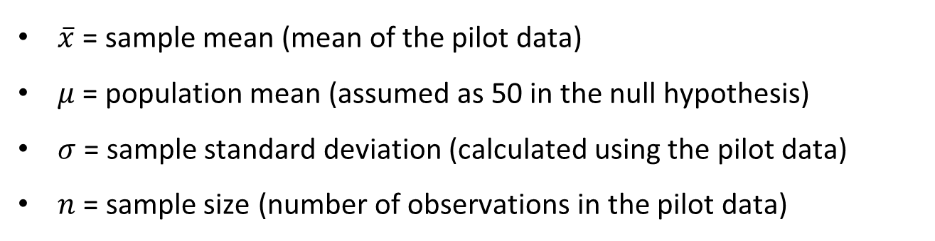

Using Inferential Statistics to Evaluate the Impact of a Public Health Policy: A Case Study of a Pilot Vaccination Program in Canberra
The formula for the t-statistic is:
$t=\frac{\overline{x}−μ}{\frac{σ}{\sqrt{n}}}$
This t-statistic is then compared to the t-distribution to calculate the p-value, which helps in determining whether to reject the null hypothesis (i.e., whether the pilot data shows significant improvement). The significance level
$\overline{x}$ = sample mean (mean of the pilot data)
$μ$= population mean (assumed as 50 in the null hypothesis)
$σ$ = sample standard deviation (calculated using the pilot data)
$n$ = sample size (number of observations in the pilot data)

Slide 46
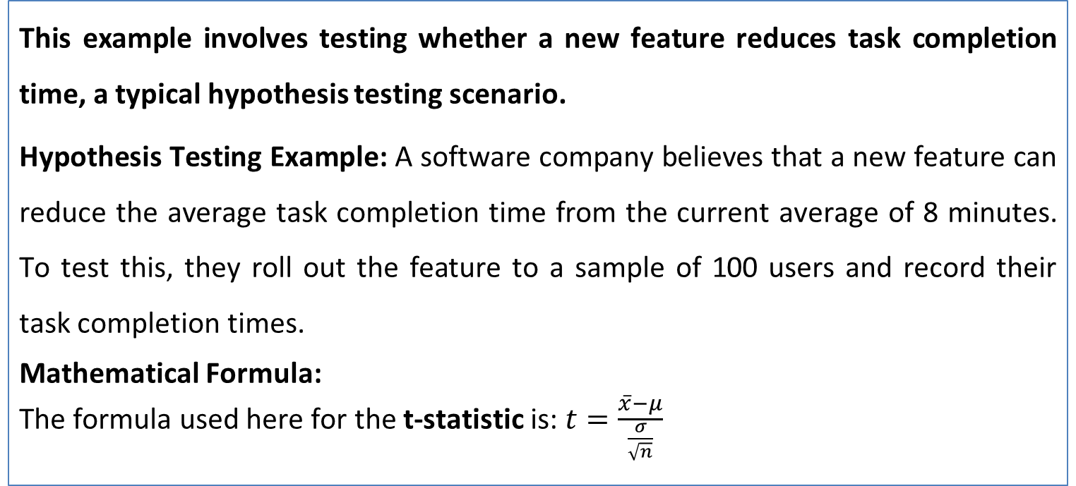
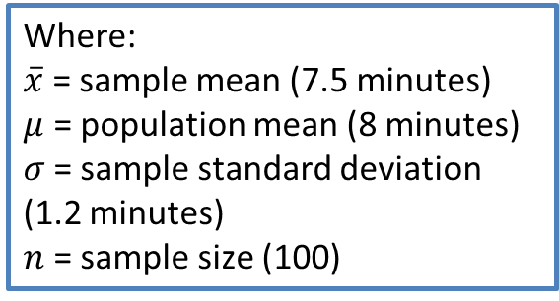
Hypothesis Testing for Task Completion Time in Software Engineering
This example involves testing whether a new feature reduces task completion time, a typical hypothesis testing scenario.
Hypothesis Testing Example: A software company believes that a new feature can reduce the average task completion time from the current average of 8 minutes. To test this, they roll out the feature to a sample of 100 users and record their task completion times.
Mathematical Formula:
The formula used here for the t-statistic is:$t=\frac{\overline{x}−μ}{\frac{σ}{\sqrt{n}}}$
Where:
$\overline{x}$ = sample mean (7.5 minutes)
$μ$ = population mean (8 minutes)
$σ$= sample standard deviation (1.2 minutes)
$n$= sample size (100)

Slide 47
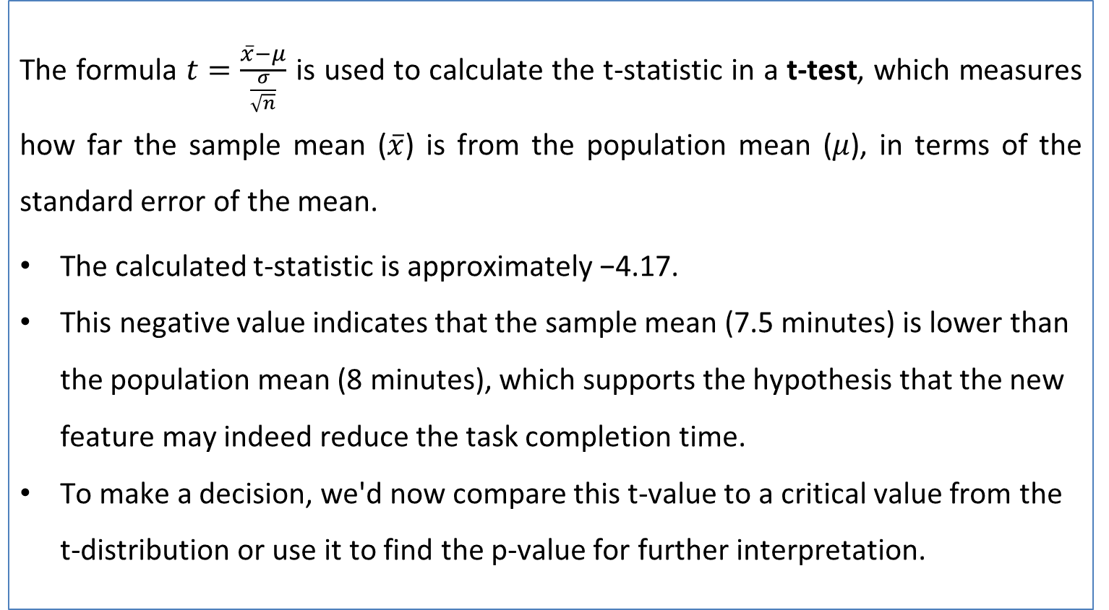
The formula $t=\frac{\overline{x}−μ}{\frac{σ}{\sqrt{n}}}$ is used to calculate the t-statistic in a t-test, which measures how far the sample mean ($\overline{x}$) is from the population mean ($μ$), in terms of the standard error of the mean.
The calculated t-statistic is approximately −4.17.
This negative value indicates that the sample mean (7.5 minutes) is lower than the population mean (8 minutes), which supports the hypothesis that the new feature may indeed reduce the task completion time.
To make a decision, we'd now compare this t-value to a critical value from the t-distribution or use it to find the p-value for further interpretation.

Slide 48
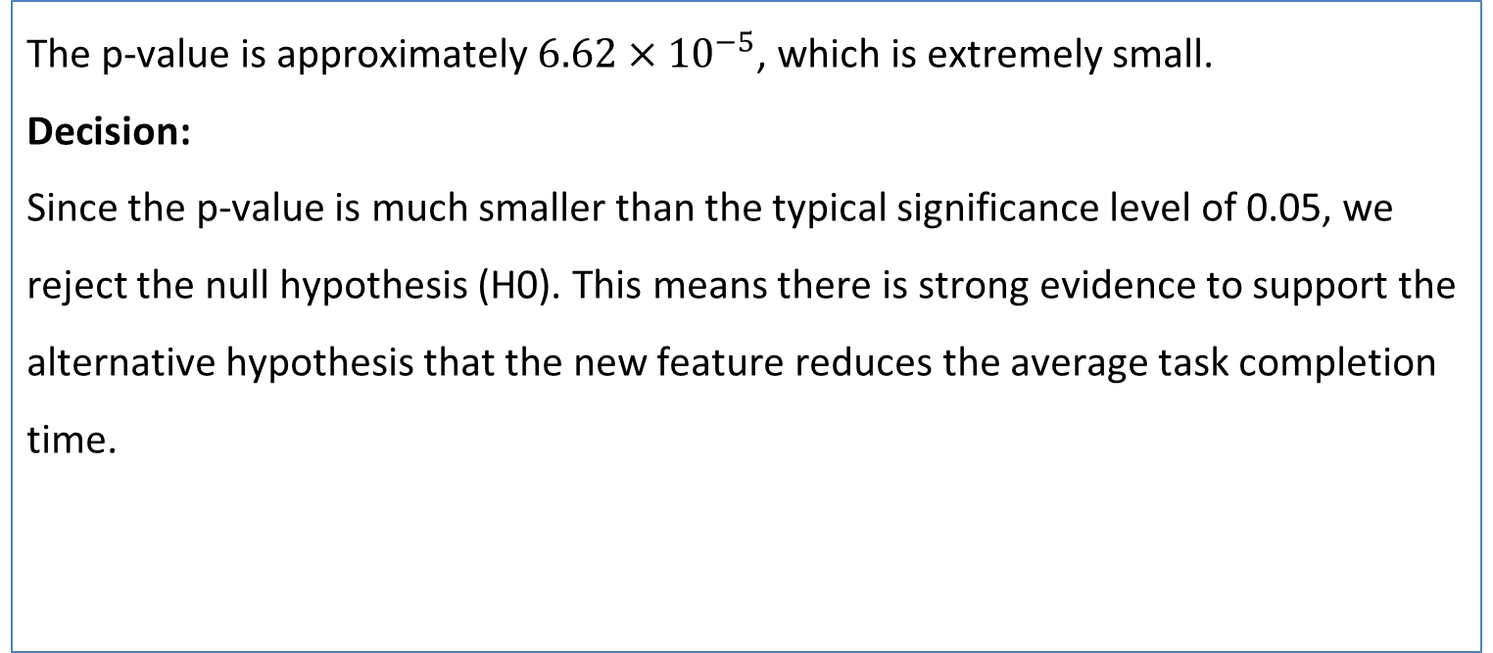
Hypothesis Testing for Task Completion Time in Software Engineering
The p-value is approximately $6.62×{10}^{−5}$, which is extremely small.
Decision:
Since the p-value is much smaller than the typical significance level of 0.05, we reject the null hypothesis (H0​). This means there is strong evidence to support the alternative hypothesis that the new feature reduces the average task completion time.

Slide 49
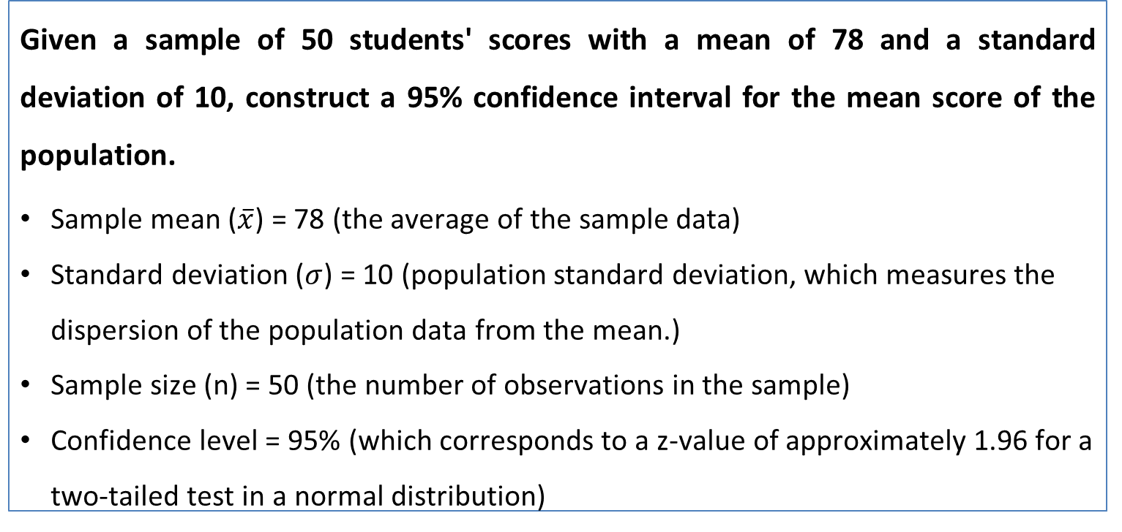
Constructing a 95% Confidence Interval for Population Mean based on Sample Data
Given a sample of 50 students' scores with a mean of 78 and a standard deviation of 10, construct a 95% confidence interval for the mean score of the population.
Sample mean ($\overline{x}$) = 78 (the average of the sample data)
Standard deviation ($σ$) = 10 (population standard deviation, which measures the dispersion of the population data from the mean.)
Sample size (n) = 50 (the number of observations in the sample)
Confidence level = 95% (which corresponds to a z-value of approximately 1.96 for a two-tailed test in a normal distribution)

Slide 50
Constructing a 95% Confidence Interval for Population Mean based on Sample Data
The 95% confidence interval for the mean score of the population is approximately [75.23,80.77].
Conclusion:
You can say with 95% confidence that the true average score of the population lies between 75.23 and 80.77 based on this sample of 50 students. This exercise is now complete.

Slide 51
Mastering Descriptive Statistics: From Basics to Real-World Applications
Introduction)
In the realm of data science, statistics emerge as a cornerstone, enabling the extraction of meaningful insights from complex datasets. As data scientists delve into the vast ocean of data, their primary tools come in the form of statistical methods designed to not only unravel the intricacies of data but also to forecast future trends and derive predictive values. This lecture focuses on descriptive statistics, a fundamental branch of statistics that plays a pivotal role in summarizing and understanding datasets. Through descriptive statistics, data scientists obtain a numerical summary that sheds light on the underlying patterns and characteristics of the data, paving the way for informed decision-making and insightful analysis.

Slide 52
Description of Descriptive Statistics
Descriptive statistics is the branch of statistics that focuses on summarizing and describing the features of a dataset. This summarization involves measures of central tendency (such as mean, median, and mode) and measures of variability (such as range, variance, and standard deviation). By employing these statistical measures, descriptive statistics provides a comprehensive overview of the data's distribution, center, and spread, thereby offering a snapshot of its characteristics without making any assumptions or drawing any conclusions about the data beyond what is presented.

Slide 53
Explanation of Key Concepts
Measures of Central Tendency: These are statistical measures to determine a single value that attempts to describe a set of data by identifying the central position within that set. The main measures are:
Mean: The average of all data points. A set of numbers found by dividing the sum of all values by the count of values.
Consider a dataset of exam scores: 75, 88, 92, 68, 82, 95, 85.
Mean: (75 + 88 + 92 + 68 + 82 + 95 + 85) / 7 = 83.57

Slide 54
Explanation of Key Concepts
1. Measures of Central Tendency: These are statistical measures to determine a single value that attempts to describe a set of data by identifying the central position within that set. The main measures are:
Median: The middle value in a data set when ordered from lowest to highest. (The middle value in a dataset when arranged in ascending order.) If there is an even number of observations, the median is the average of the two middle numbers.
Median: After sorting (68, 75, 82, 85, 88, 92, 95), the median score is 85.

Slide 55
Consider a dataset of exam scores: 75, 88, 92, 68, 82, 95, 85.
Mode: The most frequently occurring value(s) in a data set. (The value that appears most frequently in a data set.) A dataset may have one mode, more than one mode, or no mode at all.
Mode: No mode, as no score repeats.

Slide 56
2. Measures of Dispersion: These measures describe the spread of data points within a dataset.
Range: The difference between the highest and lowest values. Range: 95 – 68 = 27
Variance: Measures the dispersion of a set of data points around their mean. A measure of how much values in a dataset differ from the mean. Higher variance indicates greater spread. First, calculate the deviations from the mean for each score, square these deviations, sum them up, and divide by the number of scores.
Standard Deviation: The square root of the variance, providing a measure of the spread of data points. (It represents the average distance of each data point from the mean)

Slide 57
3. Correlation: A statistical measure that describes the extent to which two variables change together, and the direction of their relationship.
Pearson Correlation Coefficient: A measure of the linear correlation between two variables, ranging from -1 to 1.
4. Regression Analysis: A powerful statistical method used to examine the relationship between two or more variables. It’s especially useful for predicting a continuous variable.

Slide 58
5. Quartiles:
Divide data into four equal parts.
Q1 (First Quartile): The median of the first half of the dataset.
Q2 (Second Quartile or Median): Middle value of the dataset.
Q3 (Third Quartile): The median of the second half of the dataset.
6. Box Plot:
A graphical representation showing the distribution of data based on a five-number summary (Minimum, Q1, Median, Q3, Maximum).

Slide 59
Measures of Central Tendency give a single value that represents the center of the data distribution. The choice between mean, median, and mode depends on the data's nature and distribution.
Measures of Dispersion highlight the variability or spread of the data, which is crucial for understanding the reliability and precision of the central measures.
Quartiles and the Box Plot offer a deeper look into the data distribution, identifying outliers, and understanding the data's spread across its range.

Slide 60
Questions)
What does the mean represent in a dataset?
a) The middle value
b) The most frequent value
c) The average value
d) The difference between the highest and lowest values

Slide 61
Let's consider a dataset: 3, 5, 7, 8, 9, 11, 15, 17
Mean: (3+5+7+8+9+11+15+17)/8 = 9.375
Median: (8+9)/2=8.5 (since the dataset has an even number of observations)
Mode: No mode, as all values are unique.
Range: 17−3=14
Variance and Standard Deviation: Computation involves squaring the difference of each value from the mean, then averaging those squared differences for variance, and finally, taking the square root of variance for standard deviation.
Quartiles:
Q1 = Given the dataset is 3, 5, 7, 8, 9, 11, 15, 17, Q1 should be the median of the first four numbers (3, 5, 7, 8), which is 6 (the average of 5 and 7).
Q2 = 8.5 (the overall median)
Q3 calculation seems also to be slightly incorrect. For the second half of the dataset (9, 11, 15, 17), the median (Q3) should be 13 (the average of 11 and 15).
Box Plot: Visual representation based on the five-number summary.

Slide 62
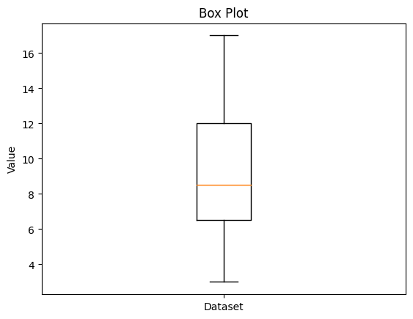
Median (Q2): The orange line in the box indicates the median of the dataset, which is the value that separates the higher half from the lower half of the data points. In this box plot, the median appears to be slightly above 8 on the value axis.
Quartiles (Q1 and Q3):
Q1: The bottom of the box represents the first quartile (Q1), the 25th percentile of the data. This is the median of the lower half of the dataset. (Q1 = 6)
Q3: The top of the box represents the third quartile (Q3), the 75th percentile. This is the median of the upper half of the dataset. (Q3 = 13)

Slide 63
Interquartile Range (IQR): The height of the box, which is the difference between Q3 and Q1, represents the interquartile range. It's the range within which the middle 50% of the data points fall. A smaller IQR indicates less variability in the middle portion of the dataset, while a larger IQR indicates more variability. (IQR = Q3 – Q1) = 13 – 6 = 7
Minimum and Maximum (Whiskers):
Minimum: The end of the lower whisker represents the smallest value in the dataset that is not considered an outlier. It appears to be around 3 on the value axis.
Maximum: The end of the upper whisker indicates the largest value that is not an outlier, which seems to be 17.
Outliers: There are no dots outside the whiskers, which means there are no outliers in this dataset according to the typical 1.5 * IQR rule for outlier detection.
Symmetry: The box appears to be slightly asymmetric. The median is closer to Q1 than Q3, which suggests that the data might be slightly left-skewed, meaning there are more data points concentrated on the lower end of the range.

Slide 64
Spread of the Data: The spread between the minimum and Q1, and between Q3 and the maximum, is quite balanced, which suggests that the data is relatively evenly distributed across its range.

Slide 65
Thank You
Have a Great Learning Day!
Feel free to reach out with any questions!

